Slide 1
Past Week
Fixed leaderboard bugs discovered in panel
Stopped POIs disappearing when master client leaves game
New mutation/horde info panel
Added tutorial slides to start of game
Started report
New map tileset!
Fixed some performance issues with large number of bots (reduced memory allocations, moved bounds calculation onto GPU)
Icons for mutation types
Flashing button to indicate when you should split your horde
Started work on score and timer with restart button
Started work making rat sprite components for 6*6*5*5 = 900 unique rat sprites
Started work on adding proper edges to the map
Started work on dynamic bot count system to keep player-level constant
Stop split-horde slider changing when population changes
SCALE TEST‼️

Slide 2
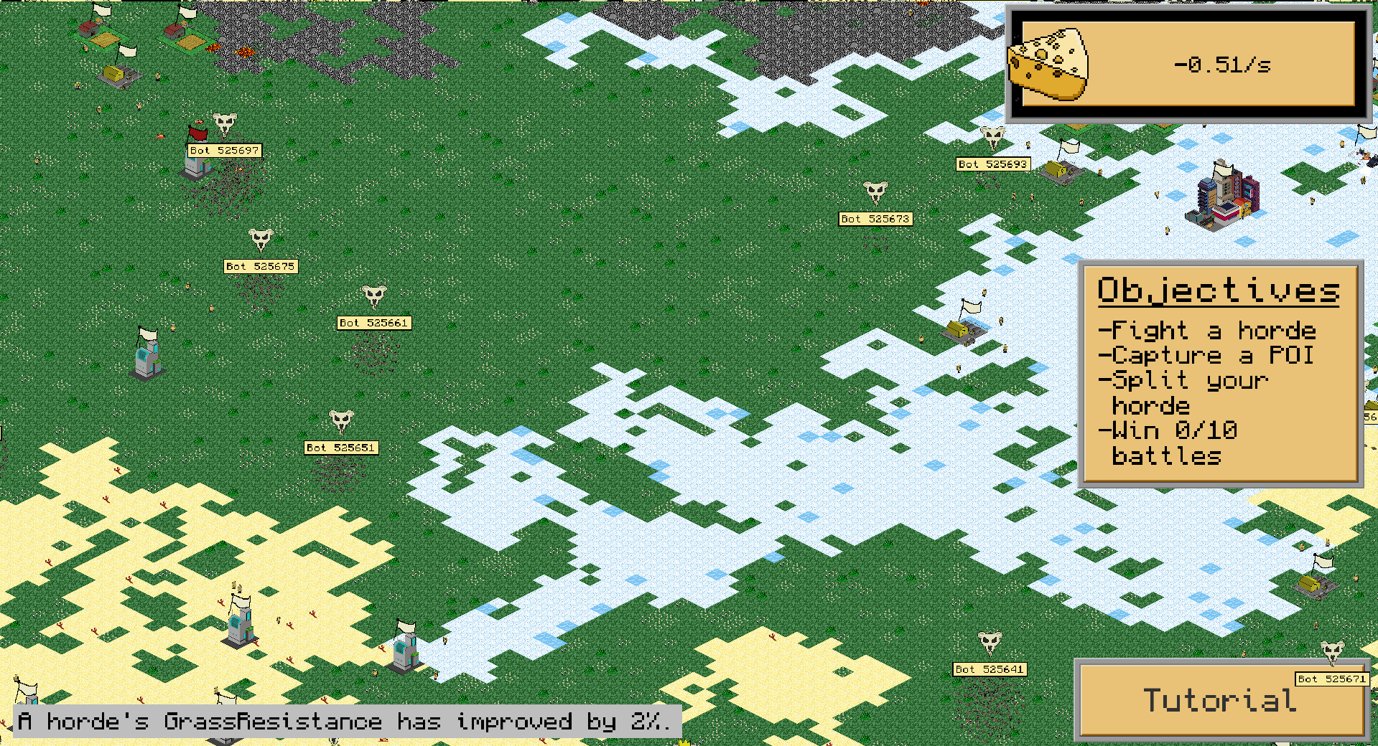
New tiles!

Slide 3
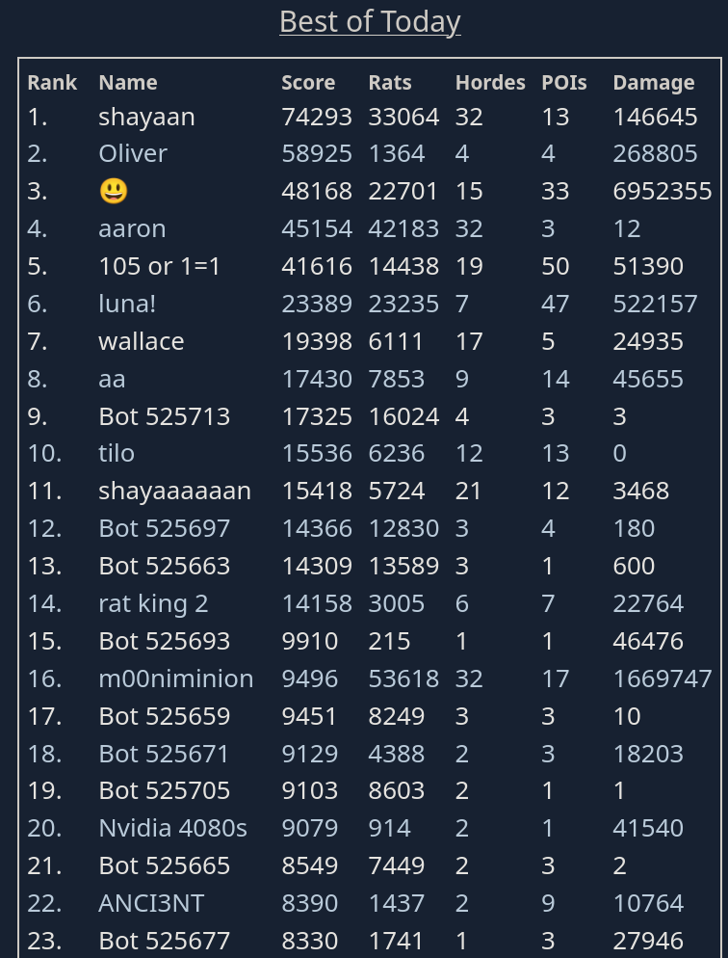
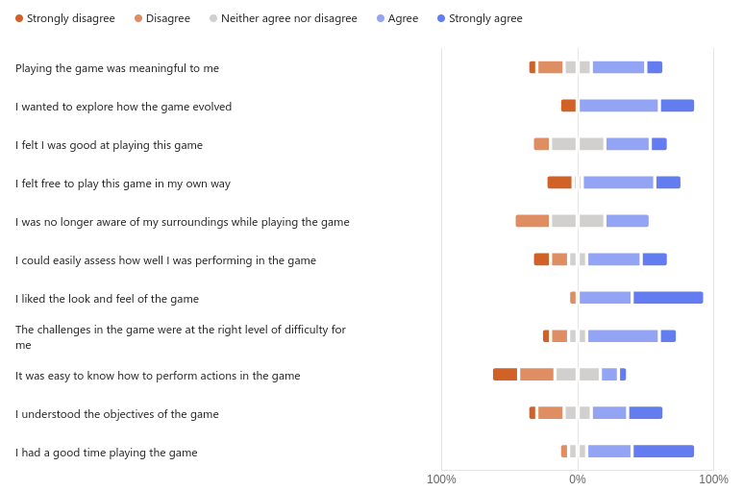
Scale Test!

Slide 4
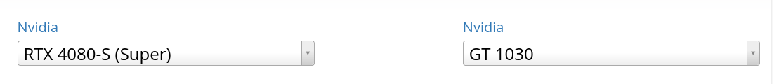



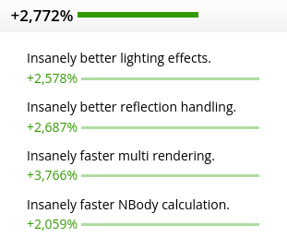
A Tragic Discovery
1.07 (Carrier Pigeons)
1.08 (Us)

Slide 5

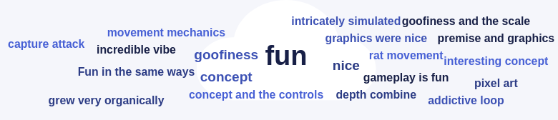
Positive Feedback

Slide 6
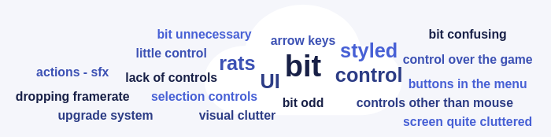
Negative Feedback

Slide 7

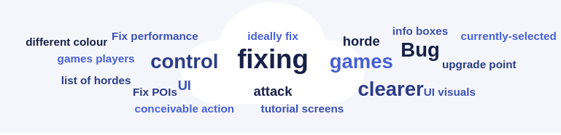
Our Focus
Bugs bugs bugs bugs bugs
Networking performance, 80% of frame-time spent on network :(
UI polish

